Slide 1

PARTS OF SPEECH

Slide 2
NOUN
- A word that names a person, a place, a thing, or an idea.
Proper nouns name a particular person, place, thing or idea and begin with a capital letter. (United States, June, and Lowes)
Common nouns do not name a particular person, place or thing and do not need capitalization. (country, month, and school)

Slide 3
PRONOUNS
- A word used instead of a noun. It is a substitute for a noun.
Jim outran the animals.
He outran them.
Other examples: (he, him, his, she, her, hers, and it)

Slide 4
VERB
- The main word in the predicate of a sentence that expresses action or being.
Action verbs tell what the subject does.(sing)
Verb phrases are verbs made up of more than one word. (is studying)
Other verbs are called helping or auxiliary verbs. (has, have)

Slide 5
PREPOSITION
- A word that shows the relationship between a noun and some other word in the sentence.
Tip: Any way that you can throw a ball would be a preposition. (up, down, in, out, and through)

Slide 6
ADJECTIVE
- A word that describes or modifies a noun or pronoun.
One adjective can change the meaning of a whole
sentence.
It was a boring day. It was an exciting day.
An adjective can tell what kind, which one, or how
many.

Slide 7
ADVERB
- A word that describes or modifies a verb, adjective or another adverb.
Adverbs that modify verbs answer:
How? (slowly)
Where? (outside)
When? (later)Or
To what extent? (thoroughly)

Slide 8
INTERJECTION
- A word or words that show feeling.
If it stands alone, it is followed by an
exclamation point. (Hey!)
If it begins a sentence, it is set off by a
comma. (Well, I never knew that.)

Slide 9

Hey! I need help, please!

Slide 10

CONJUNCTION
- A word that connects words or groups of words.
I am going to the store and by the bank.
Conjunctions work…
like a bridge.

Slide 11
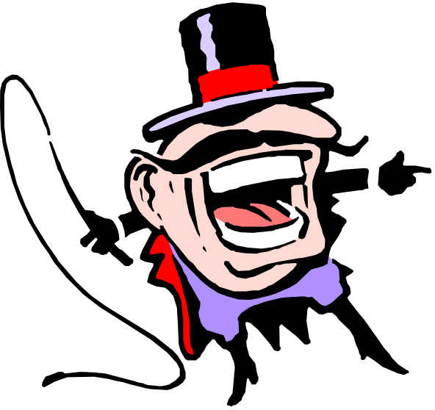
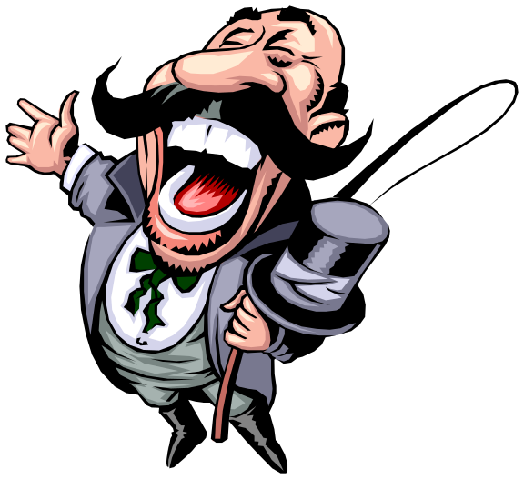
Don’t forget the eight parts of speech are: nouns, pronouns, verbs, prepositions, adjectives, adverbs, interjections….and what’s the last one?
Ha, Ha, Ha….I remember. It’s a conjunction!

Slide 12
This is it.
Now it’s your time to practice…

